Slide 1
WIPRO PJP INTERNSHIP
AUTOMATED TELLER MACHINE
PROJECT DONE BY
NAME | EMPLOYEE ID | SUPERSET ID
Uma S | 40120968 | 1265077
Vikasini D | 40120895 | 1270862
Logeshwaran B | 40117163 | 1568240
Lakshmi pavani | 40120850 | 1390644
Rohini D | 40120264 | 1354805
Dhayananth P | 40120777 | 1260299
Dhiyaneswaran T | 40120852 | 1260993
kollana Bharat kalyan | 40118925 | 1120934
Mouliswari darsiguntla | 40119956 | 1130960
Esa Kavya | 40119840 | 1120934

Slide 2
The ATM System is a project that allows people to access their bank accounts and withdraw money.
When a user needs to make a cash withdrawal, they can input their PIN number and the amount to be withdrawn will be displayed.
The sum will be debited from their account once their withdrawal was completed.
The ATM system is written in HTML, CSS, and JAVASCRIPT, using ORACLE as the back-end database.
A customer must also be able to inquire about their account balance.
A customer can also get their mini statements here.
After logging in with the credentials, the admin can view the customer's transaction data.
ABSTRACT

Slide 3
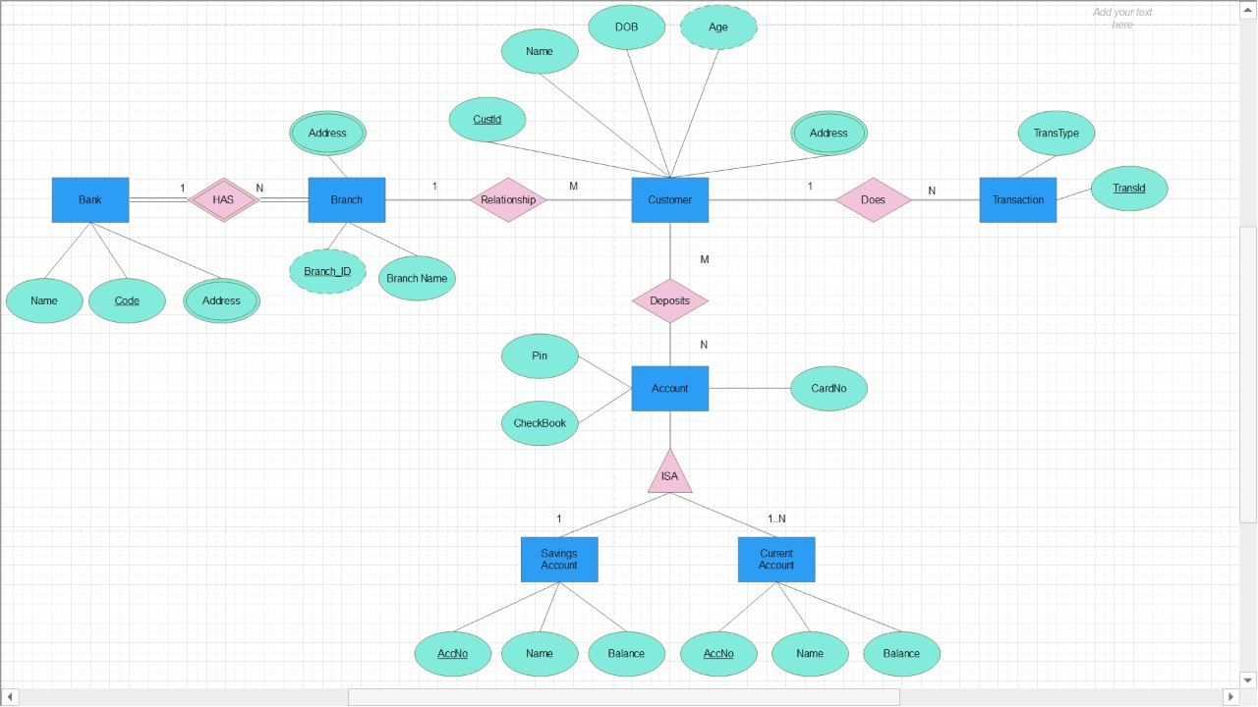
er diagram

Slide 4
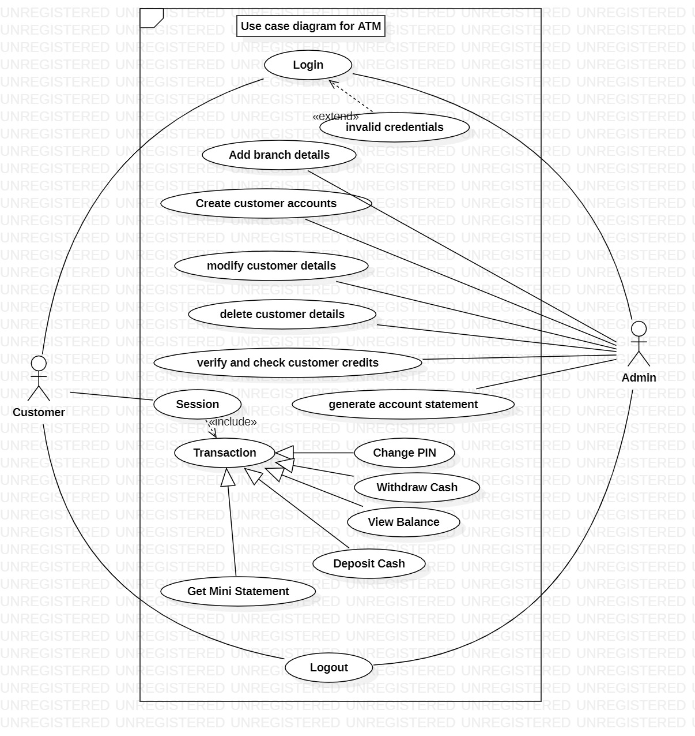
USE CASE diagram

Slide 5
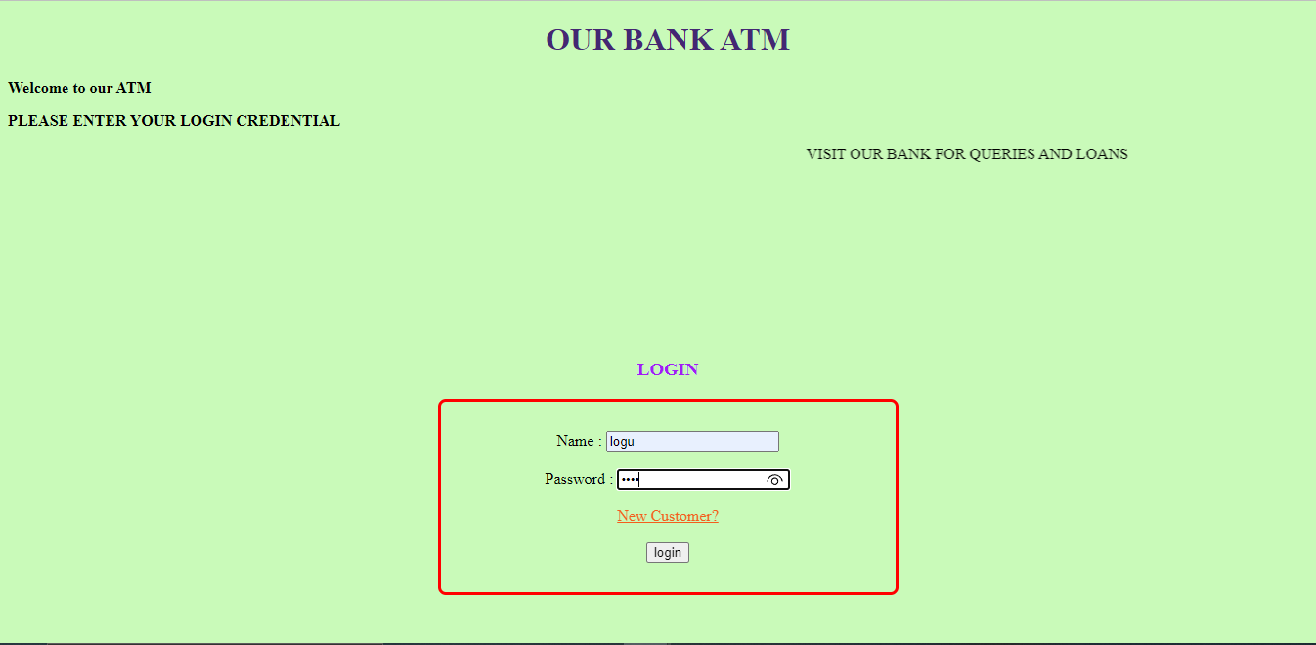
SCREENSHOTS
LOGIN PAGE

Slide 6
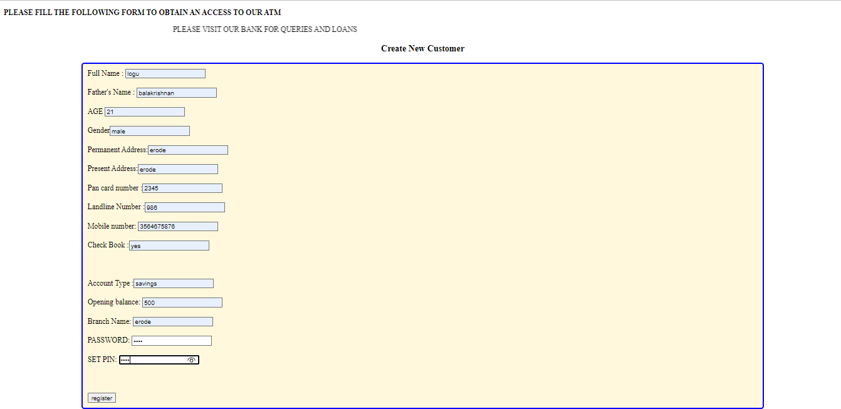
SCREENSHOTS
REGISTRATION PAGE

Slide 7
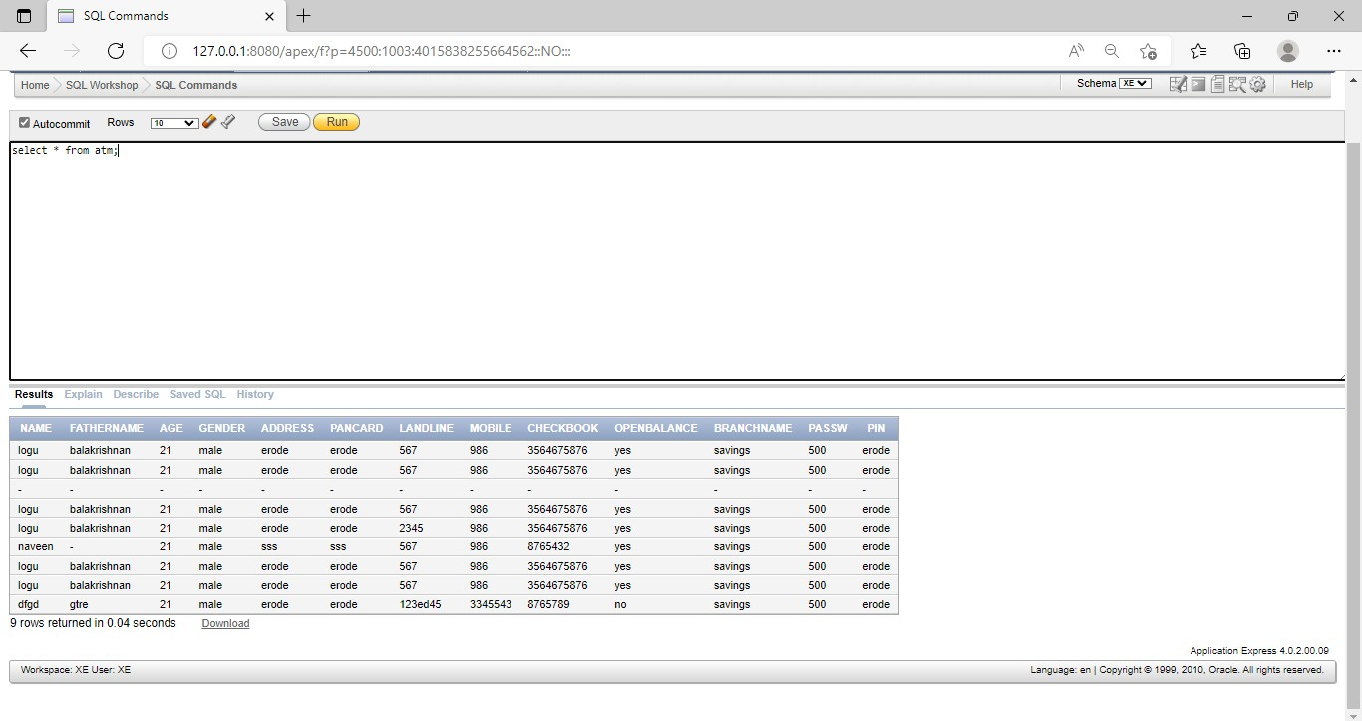
SCREENSHOTS
ADMIN CONTROL

Slide 8
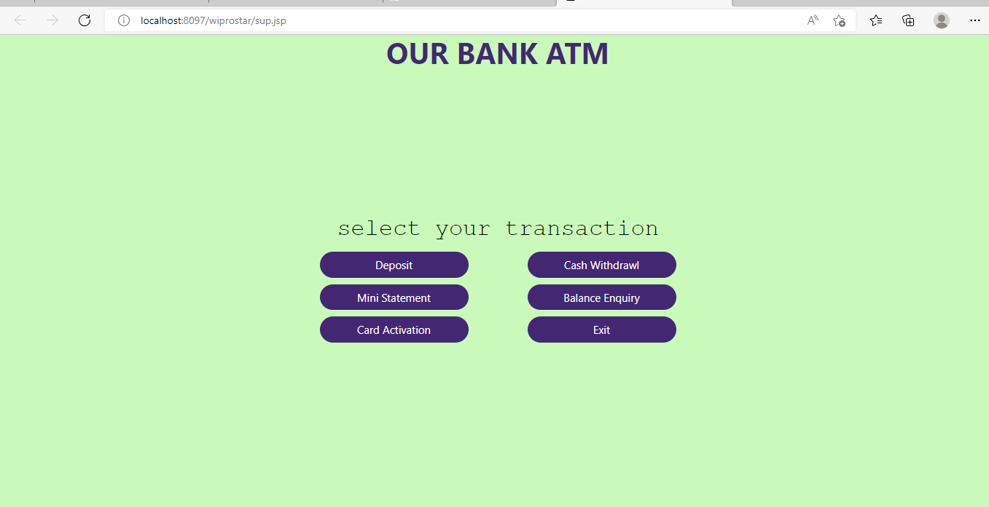
SCREENSHOTS
OPTIONS FOR CUSTOMERS

Slide 9
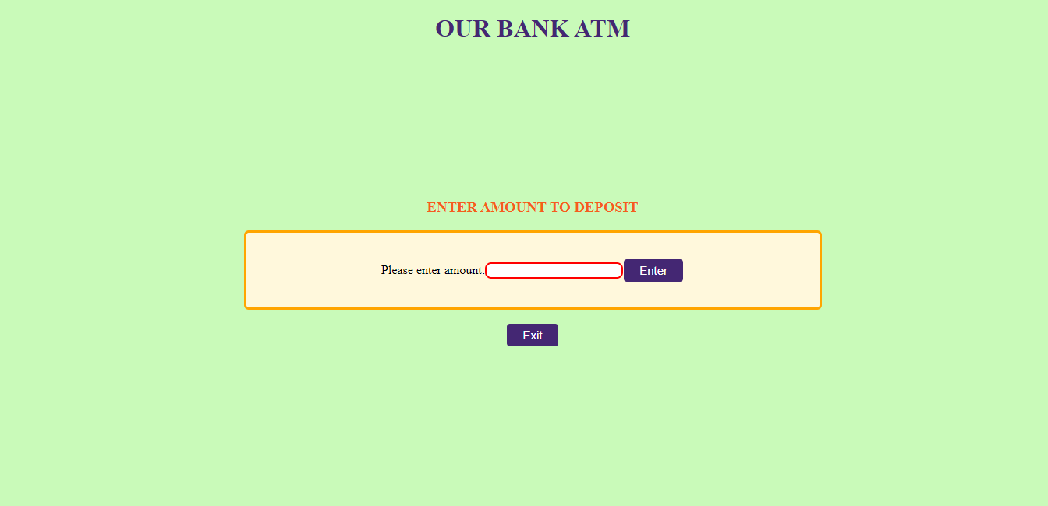
SCREENSHOTS
CUSTOMER DEPOSIT PANEL

Slide 10
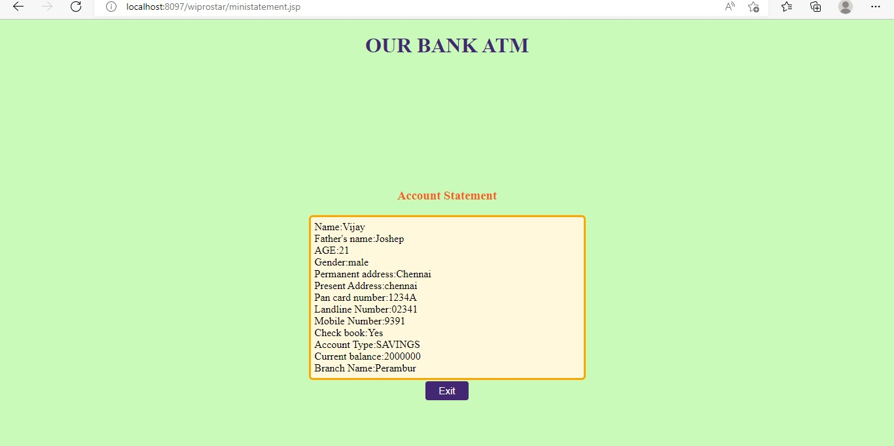
SCREENSHOTS
CUSTOMER’S MINI STATEMENT

Slide 11
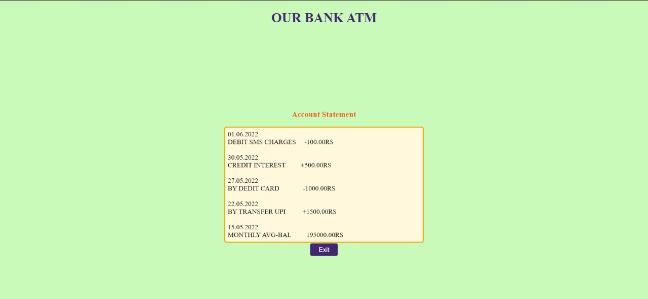
SCREENSHOTS
CUSTOMER’S MINI STATEMENT

Slide 12
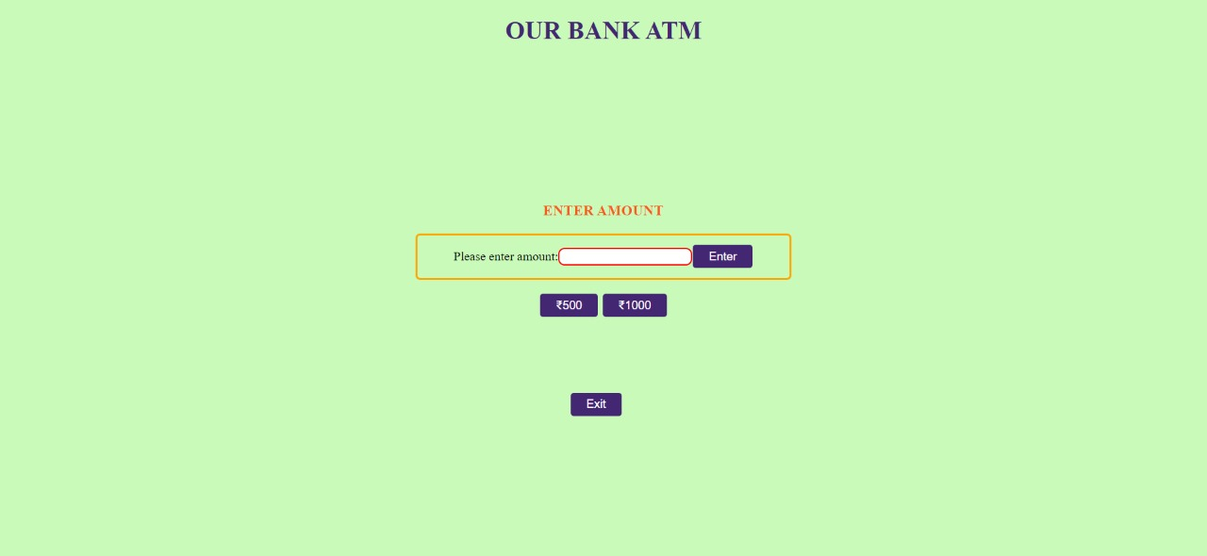
SCREENSHOTS
CASH WITHDRAWAL

